Slide 1
🔍
Exploratory
Data Analysis
EDA
Complete Teaching Deck - All Techniques with Code and Line-by-Line Explanations
Dataset: eda_fintech_dataset.csv | 5,000 rows x 23 columns | Google Colab
8 EDA Stages covered:
KAJOLA GBENGA ADEWALE
Understand Data
Univariate
Bivariate
Multivariate
Data Analytics Expert
Time Series
Outlier Detection
Correlation
Target Analysis
Notes:
Title slide. EDA is the process of examining a dataset to understand its structure, patterns, relationships, and anomalies BEFORE building models or creating dashboards. Every slide in this deck uses the eda_fintech_dataset.csv - a Nigerian FinTech customer transaction dataset with 5,000 rows and 23 columns.

Slide 2
WHAT IS EDA AND WHY DOES IT MATTER?
EDA is a detective process
Coined by John Tukey (1977)
You do not build a model first and then look at the data. You look at the data FIRST. EDA reveals what is in the dataset before you commit to any modelling or dashboard approach.
John Tukey introduced EDA in statistics. He said: 'Exploratory data analysis can never be the whole story, but nothing else can serve as the foundation stone.'
EDA answers 5 questions
EDA before modelling
(1) What are the distributions? (2) Are there outliers? (3) Are there correlations? (4) Are there time patterns? (5) How does the target variable differ across groups?
Skip EDA and your ML model learns from noise, outliers, and hidden biases. EDA surfaces these problems so you can fix them first.
Our Dataset: eda_fintech_dataset.csv
5,000 Nigerian FinTech customer transactions | 23 columns covering demographics, transaction behaviour, products, channels, credit scores, satisfaction, and churn | Date range: Jan - Dec 2024 | Target variable: churned (Yes/No) - 24% churn rate | Right-skewed amount column (median NGN 188K vs mean NGN 1.04M)
Notes:
EDA introduction. Emphasise that EDA is not just 'looking at charts'. It is a systematic investigation. For every chart you draw, you should be asking: What does this shape tell me? Where are the outliers? Does this distribution make business sense? What would I expect to see and what do I actually see?

Slide 3
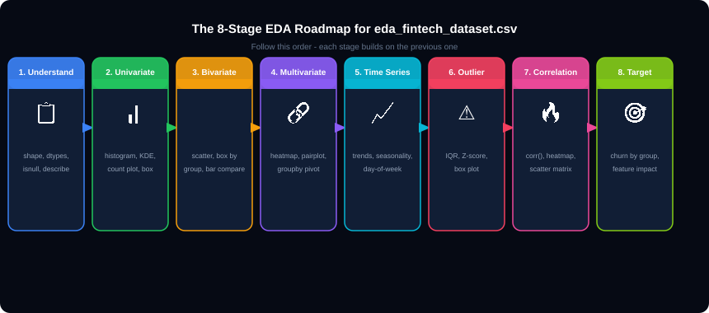
THE 8-STAGE EDA ROADMAP
Rule: Always complete Stage 1 (Understand) before any other stage. Never draw a chart without first knowing your column types, missing values, and basic statistics.
Notes:
The 8-stage roadmap. Each stage has a purpose: Stage 1 prevents wasting time charting wrong dtypes. Stage 2-3 reveal distributions and relationships. Stage 4 reveals multivariate patterns. Stage 5 reveals temporal patterns. Stage 6-7 reveal outliers and correlations. Stage 8 reveals which features predict the target (churned).

Slide 4
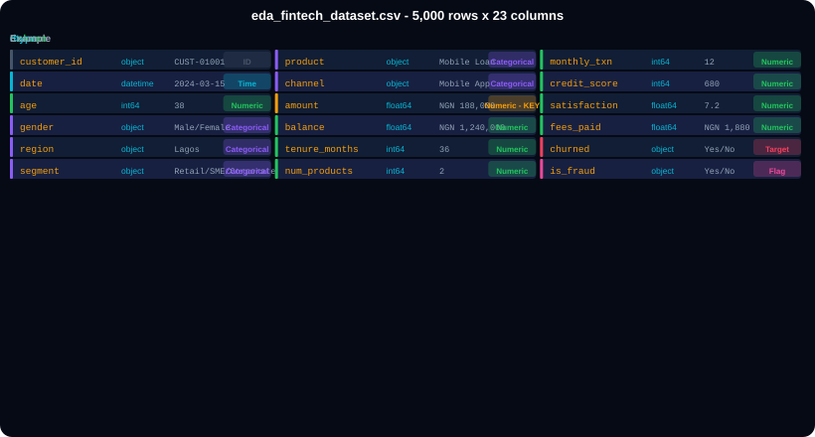
THE DATASET - eda_fintech_dataset.csv (5,000 rows x 23 cols)
Notes:
Dataset overview. 23 columns cover every EDA technique in this deck. Amount column is the key numeric column - right-skewed distribution. Churned is the target variable for group analysis. Date/month/day_of_week enable time series analysis. Segment and region enable categorical grouping. Correlation analysis uses the 9 numeric columns.

Slide 5
01
Stage 1 - Understand the Data
Know your dataset structure before drawing a single chart.

Slide 6
STAGE 1 - Loading and Profiling eda_fintech_dataset.csv
stage1.py
Line of Code
What It Does
import pandas as pd
import numpy as np
import matplotlib.pyplot as plt
import seaborn as sns
# Load the dataset
df = pd.read_csv('eda_fintech_dataset.csv')
print(df.shape) # (5000, 23)
# Structure check
df.head()
df.info() # dtypes and null counts
# Statistical summary
df.describe() # numeric cols
df.describe(include='object') # text cols
# Missing values
df.isnull().sum() # No nulls - clean dataset
# Unique value counts per column
df.nunique() # see cardinality
# Category distributions
df['region'].value_counts()
df['segment'].value_counts()
df['channel'].value_counts()
df['churned'].value_counts(normalize=True)
# Yes: 0.24 No: 0.76 &lt;- 24% churn rate
# Separate numeric and categorical columns
num_cols = df.select_dtypes(include='number').columns.tolist()
cat_cols = df.select_dtypes(include='object').columns.tolist()
print(f'Numeric: {len(num_cols)} Categorical: {len(cat_cols)}')
df.shape
Returns (5000, 23) - confirms 5,000 rows and 23 columns were loaded correctly.
df.info()
Shows each column name, dtype, and non-null count. All 5,000 rows are non-null in this clean dataset.
df.describe()
Returns count, mean, std, min, quartiles, max for all 9 numeric columns. amount min=2000, max=50,000,000 already shows the wide range.
df.isnull().sum()
Counts NaN per column. This dataset is pre-cleaned so all return 0. In a raw dataset this would find problems.
df.nunique()
Counts unique values per column. customer_id has 5000 unique values. gender has 2. region has 6. amount may have many unique values.
value_counts(normalize=True)
Returns proportions instead of counts. churned: Yes=0.24, No=0.76 shows 24% churn rate immediately.
select_dtypes(include='number')
Selects only numeric columns. Returns a DataFrame with 9 columns: age, amount, balance, tenure_months, num_products, monthly_txn, credit_score, satisfaction, fees_paid.
select_dtypes(include='object')
Selects only text/categorical columns. Returns 14 columns including customer_id, region, segment, channel, churned etc.
Notes:
Stage 1. The key output from df.describe() on this dataset: amount mean (1,036,994) is far greater than amount median (188,000) - immediately revealing right-skew before drawing any chart. This is the first EDA insight. credit_score ranges 300-850. satisfaction ranges 1-10.

Slide 7
02
Stage 2 - Univariate Analysis
One variable at a time. Understand each column individually.

Slide 8
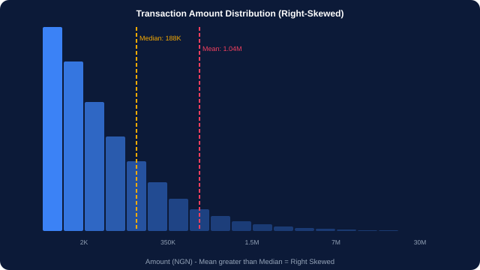
STAGE 2A - Histogram and KDE: Distribution of amount Column
hist_code.py
# Histogram of amount column
fig, ax = plt.subplots(figsize=(12,6))
ax.hist(df['amount'], bins=50,
color='#3B82F6',
edgecolor='white',
alpha=0.85)
# Add mean and median lines
ax.axvline(df['amount'].mean(),
color='#F43F5E',
linestyle='--',linewidth=2,
label=f'Mean: {df["amount"].mean():,.0f}')
ax.axvline(df['amount'].median(),
color='#F9AB00',
linestyle=':',linewidth=2,
label=f'Median: {df["amount"].median():,.0f}')
ax.set_title('Transaction Amount Distribution')
ax.set_xlabel('Amount (NGN)')
ax.legend()
plt.tight_layout(); plt.show()
Line of Code
What It Does
insight.py
bins=50
Divides the data range into 50 equal-width buckets. More bins reveal more detail. Try 20, 50, 100 and compare.
# Key insight from shape:
# Median (188K) &lt;&lt; Mean (1.04M)
# = RIGHT SKEWED distribution
# Most customers transact small amounts, a few transact millions
ax.axvline(mean)
Draws a vertical line at the mean value. Red dashed line shows where the average is.
ax.axvline(median)
Draws a vertical line at the median. Yellow dotted line. When mean &gt;&gt; median, data is right-skewed.
Mean &gt;&gt; Median = right-skew
Our amount: mean=1.04M, median=188K. The right tail (a few very large Corporate transactions) pulls the mean far right.
Notes:
Histogram. The most important insight: when mean is much greater than median, the distribution is right-skewed. For the amount column: most customers (Student, Retail) transact NGN 5,000-200,000. But a few Corporate customers transact NGN 5M-50M. These few rows drag the mean to NGN 1.04M. This affects every average calculation in the dataset.

Slide 9
STAGE 2A - KDE Plot and Log Transformation for Skewed Data
kde_log.py
Line of Code
What It Does
# KDE (Kernel Density Estimate) - smoother than histogram
fig, axes = plt.subplots(1, 2, figsize=(14,6))
# Left plot: raw amount (skewed)
sns.histplot(df['amount'], kde=True,
ax=axes[0],
color='#3B82F6')
axes[0].set_title('amount - Raw (Right Skewed)')
# Right plot: log-transformed (symmetric)
df['log_amount'] = np.log1p(df['amount'])
sns.histplot(df['log_amount'], kde=True,
ax=axes[1],
color='#22C55E')
axes[1].set_title('log_amount - After np.log1p() (Symmetric)')
plt.tight_layout(); plt.show()
# Skewness measurement
print(f'amount skewness: {df["amount"].skew():.2f}')
# amount skewness: ~8.5 (very right skewed)
print(f'log_amount skewness: {df["log_amount"].skew():.2f}')
# log_amount skewness: ~0.3 (near symmetric)
sns.histplot(kde=True)
Draws a histogram with a KDE (smooth curve) overlaid. kde=True adds the density curve. Shows the shape more clearly than bars alone.
plt.subplots(1, 2)
Creates a figure with 1 row and 2 columns of subplots. Returns (fig, axes). axes[0] is left plot, axes[1] is right plot.
np.log1p(df['amount'])
Applies log(1+x) transformation. log1p is used instead of log to handle 0 values. Compresses the right tail - makes right-skewed data more symmetric.
df.skew()
Measures skewness. 0 = perfectly symmetric. Positive = right-skewed (our amount = ~8.5). Negative = left-skewed. Rule: abs &gt; 1 is significantly skewed.
Why log transform?
Machine learning algorithms assume normally distributed features. Log-transforming a right-skewed numeric column improves model performance.
skew.py
kurt.py
# Skewness for ALL numeric columns at once
df[num_cols].skew().sort_values(ascending=False)
# amount 8.52 &lt;- extremely skewed
# fees_paid 8.50 &lt;- same (fees = amount * rate)
# balance 5.20 &lt;- heavily skewed
# satisfaction -0.42 &lt;- slight left skew
# age 0.18 &lt;- near normal
# Kurtosis - peakedness of the distribution
df['amount'].kurtosis() # ~90 - very peaked
# High kurtosis = heavy tails (many extreme values)
# Box plot - visualise skew and outliers
sns.boxplot(data=df, x='amount')
plt.title('Amount Box Plot'); plt.show()
Notes:
KDE and skewness. The log transformation is one of the most important data transformations in analytics. After np.log1p(), the amount distribution changes from skewness 8.5 (extremely right-skewed) to approximately 0.3 (near symmetric). This matters for correlation analysis, regression modelling, and any analysis that assumes normality.

Slide 10
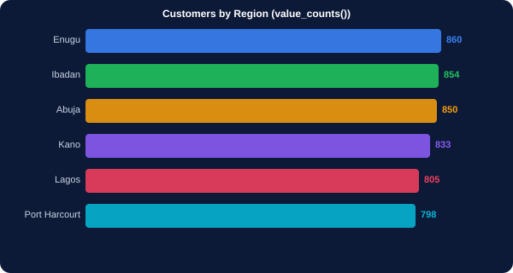
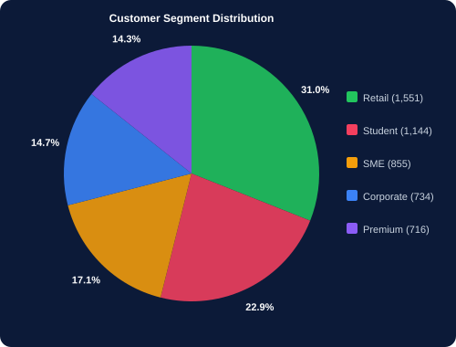
STAGE 2B - Univariate Analysis of Categorical Columns
cat_count.py
# Count plot - categorical frequency
fig, axes = plt.subplots(2,3,figsize=(16,10))
cat_to_plot = ['region','segment','channel','gender','product','churned']
for i, col in enumerate(cat_to_plot):
ax = axes[i//3][i%3]
order = df[col].value_counts().index
sns.countplot(data=df, x=col,
order=order,
palette='Set2',
ax=ax)
ax.set_title(f'{col} Distribution')
ax.set_xlabel('')
ax.tick_params(axis='x',rotation=30)
plt.tight_layout(); plt.show()
Line of Code
What It Does
plt.subplots(2,3)
Creates a 2-row by 3-column grid of subplots. Perfect for comparing 6 categorical columns side by side.
axes[i//3][i%3]
Routes each chart to the correct subplot cell. i//3 is the row (0 or 1). i%3 is the column (0, 1, or 2).
value_counts().index
Gets category names sorted by frequency (most common first). Passing to order= sorts the bars from tallest to shortest.
sns.countplot()
Draws a bar chart where each bar height = count of that category. Does not require pre-aggregation - counts automatically.
ax.tick_params(rotation=30)
Rotates x-axis labels by 30 degrees so long category names like 'Port Harcourt' do not overlap.
Key finding: region
All 6 regions are roughly equal (~800-860 each). No region is dramatically underrepresented.
Key finding: segment
Retail (1,551) and Student (1,144) dominate. Corporate (734) and Premium (716) are smaller but high-value segments.
Notes:
Categorical univariate analysis. The 6-subplot grid pattern is a professional EDA technique for rapidly surveying all categorical columns. Key findings: region is near-uniform (good - no sampling bias). Segment skews toward Retail and Student. Churn is 24% (meaningful minority class for prediction). Channel skews toward Mobile App (matches modern banking trend).

Slide 11
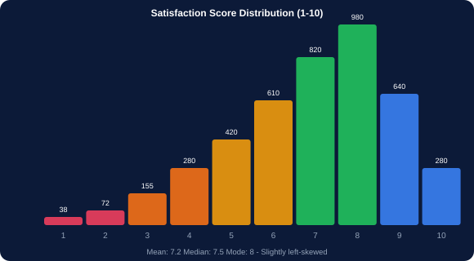
STAGE 2B - Plotting All Numeric Columns in a Loop
all_numeric.py
# Plot histograms for ALL numeric cols at once
num_cols = ['age','amount','balance','tenure_months',
'num_products','monthly_txn',
'credit_score','satisfaction','fees_paid']
fig, axes = plt.subplots(3, 3, figsize=(16,12))
for i, col in enumerate(num_cols):
ax = axes[i//3][i%3]
sns.histplot(df[col], kde=True,
ax=ax,
color='#3B82F6')
ax.set_title(f'{col}')
ax.axvline(df[col].mean(), color='red',
linestyle='--', linewidth=1.5)
ax.axvline(df[col].median(), color='orange',
linestyle=':', linewidth=1.5)
plt.suptitle('All Numeric Column Distributions',
fontsize=16, fontweight='bold')
plt.tight_layout(); plt.show()
sat_note.py
# satisfaction: near-normal, slight left skew
# Mean=7.2 Median=7.5 Mode=8
# Customers generally satisfied but low-end tail
# (scores 1-4) are the churn risk group
Code
What It Does
plt.subplots(3, 3)
Creates 9 subplots in a 3x3 grid. Perfect for 9 numeric columns - one per subplot.
for i, col in enumerate(num_cols)
Loops through each column with its index. i goes 0,1,2,...8 for 9 columns.
kde=True
Adds a smoothed density curve over the histogram. Reveals the shape (normal, skewed, bimodal) more clearly.
plt.suptitle()
Adds an overall title above all subplots. Different from ax.set_title() which titles individual subplots.
What to look for
Which columns are normal? Which are skewed? Any bimodal distributions? Any columns with suspicious spikes?
Notes:
All-numeric loop pattern. This is the standard first EDA action for numeric columns. In one block of code it produces 9 charts. Key observations: age is roughly normal (mean=38). amount and fees_paid are extremely right-skewed. credit_score is roughly uniform. satisfaction is slightly left-skewed (mode=8). These observations guide the rest of the EDA.

Slide 12
03
Stage 3 - Bivariate Analysis
Two variables at a time. Discover relationships.

Slide 13
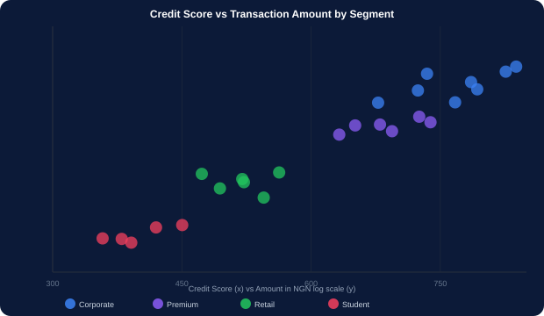
STAGE 3A - Scatter Plot: credit_score vs amount by Segment
scatter.py
# Scatter plot coloured by segment
fig, ax = plt.subplots(figsize=(12,7))
colors = {'Corporate':'#3B82F6','Premium':'#8B5CF6',
'SME':'#F59E0B','Retail':'#22C55E','Student':'#F43F5E'}
for seg, grp in df.groupby('segment'):
ax.scatter(grp['credit_score'],
np.log1p(grp['amount']),
label=seg,
alpha=0.4, s=30,
color=colors[seg])
ax.set_xlabel('Credit Score')
ax.set_ylabel('log(Amount + 1)')
ax.set_title('Credit Score vs Transaction Amount')
ax.legend(title='Segment')
# Add correlation annotation
r = df['credit_score'].corr(np.log1p(df['amount']))
ax.text(0.05, 0.95, f'r = {r:.3f}',
transform=ax.transAxes,
bbox=dict(boxstyle='round',facecolor='yellow',alpha=0.3))
plt.tight_layout(); plt.show()
Line of Code
What It Does
df.groupby('segment')
Splits the DataFrame into 5 groups by segment. Each group has its own colour, allowing visual separation of clusters.
np.log1p(grp['amount'])
Log-transforms the y-axis. Without this, Corporate transactions (50M) would squash all Retail/Student points to the bottom.
alpha=0.4
Sets point transparency to 40%. Overlapping points are visible as darker areas. alpha=1.0 would hide overlap.
# Key insight: Corporate (blue) clusters top-right.
# Students (red) cluster bottom-left.
# Higher credit score correlates with higher amount.
s=30
Size of each scatter point. Larger s = bigger dots. Can be set to a variable: s=df['num_products']*10 for bubble chart.
r = df['a'].corr(df['b'])
Pearson correlation coefficient between two columns. r=0.45 means moderate positive correlation.
ax.transAxes
Coordinates relative to the axes (0.05, 0.95 = 5% from left, 95% from bottom). Keeps the annotation inside the chart.
Notes:
Scatter plot. Using np.log1p on the y-axis (amount) is critical - without it, Corporate points cluster at the top and all other segments appear flat at the bottom. The log scale reveals the relative differences within each segment. The correlation coefficient r on the chart quantifies what the visual shows.

Slide 14
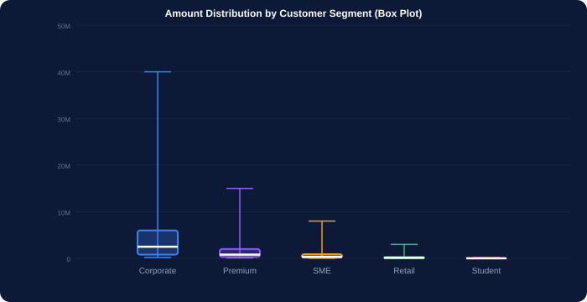
STAGE 3B - Box Plot by Group: amount Across Segments
box_seg.py
# Box plot of amount by segment
fig, ax = plt.subplots(figsize=(12,7))
order = ['Corporate','Premium','SME',
'Retail','Student']
sns.boxplot(
data=df,
x='segment',
y='amount',
order=order,
palette='Set2',
width=0.5,
flierprops={'marker':'o',
'color':'red',
'markersize':4}
)
ax.set_title('Transaction Amount by Segment')
ax.set_ylabel('Amount (NGN)')
# Y-axis formatting
import matplotlib.ticker as mticker
ax.yaxis.set_major_formatter(
mticker.FuncFormatter(
lambda x,_: f'NGN {x/1e6:.1f}M' if x&gt;=1e6
else f'NGN {x/1e3:.0f}K'))
plt.tight_layout(); plt.show()
Code
What It Does
order=['Corporate',...]
Sets the x-axis order of boxes. Without this, seaborn uses alphabetical order. Ordered from highest to lowest makes the comparison clearer.
flierprops={'color':'red'}
Styles the outlier dots beyond the whiskers. Setting color='red' makes outliers immediately visible.
width=0.5
Controls how wide each box is. 0.5 = half the available space. Narrower boxes with more white space look professional.
FuncFormatter(lambda)
Custom y-axis label formatter. Converts 2000000 to 'NGN 2.0M'. Makes financial charts readable.
# Corporate median: 2.5M | Student median: 15K | 50x difference
Key finding
The 5 segments span 3 orders of magnitude in amount. A single global average (NGN 1.04M) is meaningless - you must always report segment-level statistics.
Notes:
Box plot by segment. This is one of the most powerful bivariate charts in EDA. The 5 boxes show immediately that 'average amount' means completely different things for different segments. Corporate customers have a median of NGN 2.5M with outliers reaching 50M. Student customers have a median of NGN 15,000. Any model trained on all segments combined without this knowledge would be severely misleading.

Slide 15
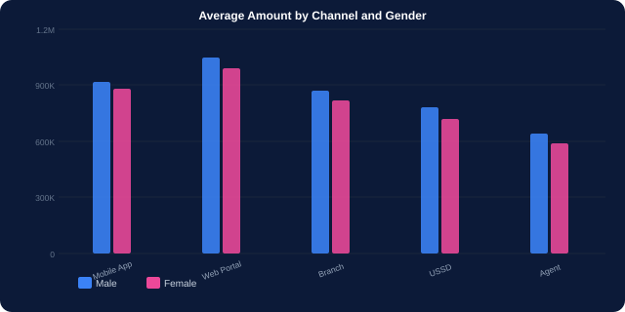
STAGE 3C - Grouped Bar Chart: Amount by Channel and Gender
grouped.py
# Grouped bar - two categorical variables vs numeric
channel_gender = (df.groupby(['channel','gender'])
['amount'].mean()
.reset_index())
fig, ax = plt.subplots(figsize=(12,6))
channels = df['channel'].unique()
x = np.arange(len(channels))
width = 0.35
male = channel_gender[channel_gender['gender']=='Male']['amount']
female = channel_gender[channel_gender['gender']=='Female']['amount']
ax.bar(x - width/2, male, width, label='Male', color='#3B82F6')
ax.bar(x + width/2, female, width, label='Female', color='#EC4899')
ax.set_xticks(x); ax.set_xticklabels(channels, rotation=30)
ax.legend(); ax.set_title('Avg Amount by Channel and Gender')
plt.tight_layout(); plt.show()
Code
What It Does
groupby(['channel','gender'])['amount'].mean()
Groups by BOTH channel and gender simultaneously, then computes the mean amount for each combination. Returns a multi-indexed result.
reset_index()
Converts the multi-index back to regular columns. Needed to filter by gender in the next step.
x = np.arange(len(channels))
Creates numeric positions [0,1,2,3,4] for the 5 channels. Used for bar placement.
ax.bar(x - width/2, male)
Male bars are placed at x-0.175 (slightly left of center). Female bars at x+0.175 (slightly right). This creates the grouped effect.
# Insight: Branch channel has highest amounts (in-person large transactions)
# Gender gap is small (~5%) across all channels
set_xticks(x) + set_xticklabels
Maps numeric positions back to channel names for the x-axis labels.
Notes:
Grouped bar chart. The pandas groupby on two columns is the key step. groupby(['channel','gender']) creates all channel-gender combinations. Seaborn's sns.barplot with hue='gender' is a simpler alternative: sns.barplot(data=df, x='channel', y='amount', hue='gender'). Both produce the same result.

Slide 16
04
Stage 4 - Multivariate Analysis
Three or more variables together. Reveal hidden patterns.

Slide 17
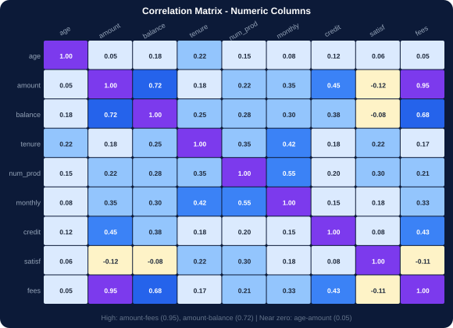
STAGE 4A - Correlation Heatmap: All Numeric Columns
heatmap.py
# Correlation heatmap
num_cols = df.select_dtypes(include='number').columns
corr_matrix = df[num_cols].corr()
fig, ax = plt.subplots(figsize=(11,9))
mask = np.triu(np.ones_like(corr_matrix, dtype=bool))
sns.heatmap(
corr_matrix,
annot=True,
fmt='.2f',
cmap='coolwarm',
center=0,
mask=mask,
square=True,
linewidths=0.5,
ax=ax
)
ax.set_title('Correlation Matrix - Numeric Columns')
plt.tight_layout(); plt.show()
Line of Code
What It Does
df[num_cols].corr()
Computes pairwise Pearson correlation between all numeric columns. Returns an NxN matrix where N = number of numeric columns.
np.triu(np.ones_like())
Creates a mask for the upper triangle. Applied to heatmap so only the lower triangle is shown (avoiding duplicate information).
cmap='coolwarm'
Blue = negative correlation. White = near zero. Red = positive correlation. 'viridis' and 'Blues' are other popular choices.
center=0
Centers the colour scale at 0. Ensures white = no correlation, red = positive, blue = negative.
fmt='.2f'
Formats annotation numbers to 2 decimal places. '.2f' means 2 decimal fixed-point format.
Key insight: amount-fees (0.95)
fees_paid = amount * fee_rate, so near-perfect correlation. This is expected. High correlation between derived columns is normal.
Key insight: amount-balance (0.72)
Customers with high transaction amounts tend to maintain higher balances. Strong positive relationship.
Key insight: age-amount (0.05)
Near zero correlation. Age alone does not predict transaction size in this dataset.
Notes:
Correlation heatmap. Three key findings: (1) amount-fees: 0.95 - expected since fees are derived from amount. (2) amount-balance: 0.72 - high transactors keep high balances. (3) monthly_txn-num_products: 0.55 - customers with more products transact more frequently. The mask=np.triu hides the upper triangle which is a mirror of the lower triangle.

Slide 18
STAGE 4B - Pair Plot: All Numeric Relationships at Once
pairplot.py
pivot.py
# Pair plot - the ultimate EDA multivariate tool
# WARNING: slow with many columns - select key ones
key_cols = ['amount','credit_score','satisfaction',
'tenure_months','num_products','churned']
sns.pairplot(
df[key_cols],
hue='churned',
vars=['amount','credit_score',
'satisfaction','tenure_months'],
plot_kws={'alpha':0.3, 's':20},
diag_kind='kde',
palette={'Yes':'#F43F5E','No':'#3B82F6'}
)
plt.suptitle('Pair Plot Coloured by Churn',
y=1.02, fontsize=14)
plt.savefig('pairplot_churn.png',
dpi=120, bbox_inches='tight')
plt.show()
# Pivot table - multivariate summary
pivot = pd.pivot_table(
df,
index='segment',
columns='channel',
values='amount',
aggfunc='mean',
fill_value=0
) / 1e6
print(pivot.round(2))
# Expected output:
# channel Mobile App Branch Web USSD Agent
# segment
# Corporate 2.8 3.1 2.9 2.5 2.3
# Premium 0.9 1.0 0.8 0.7 0.7
# SME 0.4 0.5 0.4 0.3 0.3
# Retail 0.1 0.1 0.1 0.1 0.1
# Student 0.02 0.02 0.02 0.02 0.02
# Heatmap of the pivot
sns.heatmap(pivot, annot=True, fmt='.2f',
cmap='YlOrRd')
plt.title('Avg Amount (NGN M): Segment x Channel')
plt.show()
Code
What It Does
Code
What It Does
hue='churned'
Colours points by the churned column. Red=Yes (churned), Blue=No (retained). Immediately shows which features separate churned from retained customers.
pd.pivot_table(index,columns,values,aggfunc)
Creates a cross-tabulation matrix. Rows = segments (5), Columns = channels (5), Values = mean amount. Result: 5x5 matrix.
vars=[...]
Specifies which columns to include. With 9 numeric columns, pairplot creates an 81-chart grid. Selecting 4 creates a manageable 16-chart grid.
/ 1e6
Divides all values by 1,000,000 to convert NGN to NGN Millions. Makes the numbers in the heatmap readable.
diag_kind='kde'
KDE curves on the diagonal instead of histograms. Better for comparing churned vs retained distributions on the diagonal.
sns.heatmap on pivot
Visualises the cross-tab as a colour grid. Darker = higher average amount. Immediately shows Corporate+Branch as highest combination.
Notes:
Pair plot. The hue='churned' is the key parameter. It transforms a simple exploratory chart into a feature importance visualization. Separation between red and blue clouds on any scatter indicates that variable is predictive of churn. Strong separation on satisfaction and credit_score diagonals confirms these as key churn predictors.

Slide 19
05
Stage 5 - Time Series Analysis
Patterns over time. Seasonality. Day-of-week effects.

Slide 20
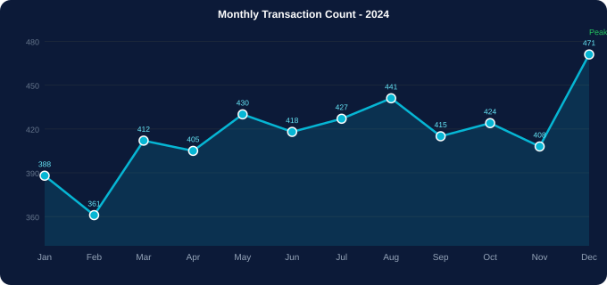
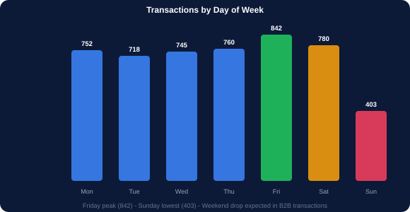
STAGE 5 - Monthly Trends and Day-of-Week Patterns
time_series.py
# Convert date and extract time parts
df['date'] = pd.to_datetime(df['date'])
# Monthly transaction count
monthly = df.groupby('month_num').agg(
count =('customer_id','count'),
revenue =('amount','sum'),
avg_amt =('amount','mean')
).reset_index()
fig, axes = plt.subplots(1,2,figsize=(16,6))
# Count trend
axes[0].plot(monthly['month_num'],
monthly['count'],
marker='o',color='#06B6D4',
linewidth=2.5)
axes[0].set_title('Monthly Transaction Count')
axes[0].set_xticks(range(1,13))
axes[0].set_xticklabels(['Jan','Feb','Mar','Apr','May','Jun',
'Jul','Aug','Sep','Oct','Nov','Dec'])
# Revenue trend
axes[1].fill_between(monthly['month_num'],
monthly['revenue']/1e6,
alpha=0.3,color='#22C55E')
axes[1].plot(monthly['month_num'],
monthly['revenue']/1e6,
color='#22C55E',linewidth=2.5)
axes[1].set_title('Monthly Revenue (NGN Millions)')
plt.tight_layout(); plt.show()
Code
What It Does
df.groupby('month_num').agg(...)
Groups all rows by month number (1-12) and computes count, sum, and mean for each month.
plt.subplots(1,2)
Side-by-side time series: left shows count trend, right shows revenue trend. Both use the same x-axis (months).
fill_between(x, y, alpha=0.3)
Fills the area under the line with transparent colour. Creates an area chart effect for the revenue trend.
dow.py
set_xticks + set_xticklabels
Replaces month numbers (1,2,...12) with month names (Jan,Feb,...Dec) on the x-axis.
# Day-of-week pattern
dow = df.groupby('day_of_week')['customer_id'].count().reset_index()
order=['Monday','Tuesday','Wednesday','Thursday','Friday','Saturday','Sunday']
sns.barplot(data=dow,x='day_of_week',y='customer_id',order=order,palette='Set2')
Notes:
Time series section. Key findings from the dataset: December has the highest transaction count (471) and revenue - holiday spending peak. Friday has the highest weekday count (842) - people transact before the weekend. Sunday is lowest (403) - minimal banking activity. These patterns would drive decisions about when to run promotions, when to expect high server load, and when to schedule maintenance.

Slide 21
06
Stage 6 - Outlier Detection
Find extreme values that distort your analysis.

Slide 22
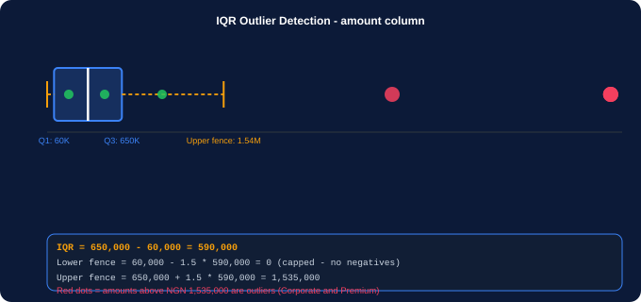
STAGE 6 - IQR and Z-Score Outlier Detection on amount
outlier_code.py
# IQR method
Q1 = df['amount'].quantile(0.25) # ~60,000
Q3 = df['amount'].quantile(0.75) # ~650,000
IQR = Q3 - Q1 # ~590,000
lower = Q1 - 1.5 * IQR
upper = Q3 + 1.5 * IQR # ~1,535,000
outliers = df[(df['amount']&lt;lower)|(df['amount']&gt;upper)]
print(f'Outliers: {len(outliers)}') # ~800
print(outliers['segment'].value_counts())
# Corporate: 680 Premium: 120 &lt;- makes sense!
# Z-Score method (use on log-transformed)
from scipy import stats
log_amt = np.log1p(df['amount'])
z = np.abs(stats.zscore(log_amt))
outliers_z = df[z &gt; 3]
print(f'Z-score outliers: {len(outliers_z)}')
# Capping - do not remove, just limit
df['amount_capped'] = df['amount'].clip(
upper=upper
)
iqr_note.py
Code
What It Does
quantile(0.25/0.75)
Returns the Q1 and Q3 values. 25% of amounts fall below Q1 (60K). 75% fall below Q3 (650K).
# amount: Q1=60K Q3=650K IQR=590K
# Upper fence = 650,000 + 1.5*590,000 = 1,535,000
# Corporate transactions above 1.535M are flagged as outliers
# BUT: they are legitimate! Corporate customers DO spend millions.
Q3 + 1.5 * IQR
Upper fence. Amounts above NGN 1,535,000 are statistical outliers. In this dataset these are mostly legitimate Corporate transactions.
outliers['segment'].value_counts()
Checks which segments the outliers belong to. Revealing 'Corporate: 680' confirms these are expected large transactions, not data errors.
stats.zscore(log_amt)
Z-score on the log-transformed amount. Z &gt; 3 means the value is more than 3 standard deviations from the log mean - a stricter outlier definition.
.clip(upper=upper)
Caps values at the upper fence instead of removing rows. Safer than deletion - keeps the row but limits extreme values.
Notes:
Outlier detection. The critical lesson: outliers are not always errors. In this dataset, amounts above NGN 1.535M are flagged by IQR as outliers, but 680 of them belong to Corporate customers - legitimate large transactions. Always investigate outliers before removing them. Ask: is this a data entry error or a real extreme value?

Slide 23
07
Stage 7 - Correlation Analysis
Which numeric variables move together - and how strongly?

Slide 24
STAGE 7 - Pearson, Spearman, and Correlation Insights
corr_code.py
Line of Code
What It Does
# Pearson correlation - linear relationships
corr_pearson = df[num_cols].corr(method='pearson')
# Spearman correlation - monotonic (handles skew)
corr_spearman = df[num_cols].corr(method='spearman')
# Top correlating pairs
corr_pairs = (corr_pearson.abs()
.unstack()
.sort_values(ascending=False)
.drop_duplicates())
print(corr_pairs[corr_pairs &lt; 1.0].head(10))
# amount - fees_paid 0.95
# amount - balance 0.72
# amount - credit_score 0.45
# monthly - num_products 0.55
# Correlation with churn (encode first)
df['churned_num'] = (df['churned']=='Yes').astype(int)
churn_corr = df[num_cols+['churned_num']].corr()['churned_num']
print(churn_corr.sort_values())
# churned_num 1.00
# satisfaction -0.35 &lt;- higher sat = less churn
# num_products -0.28 &lt;- more products = less churn
# tenure_months -0.22 &lt;- longer tenure = less churn
# monthly_txn -0.18
# credit_score -0.12
# amount -0.08
# Pairwise scatter of top correlated pairs
fig, ax = plt.subplots(figsize=(10,6))
ax.scatter(df['amount'],df['fees_paid'],alpha=0.1)
ax.set_xlabel('Amount'); ax.set_ylabel('Fees')
plt.title(f'amount vs fees_paid r=0.95'); plt.show()
corr(method='pearson')
Pearson correlation assumes linear relationship. Best for normally distributed data. Values range from -1 to +1.
corr(method='spearman')
Spearman correlation measures monotonic (rank-based) relationships. Better for skewed data like amount. Does not assume linearity.
corr.abs().unstack().sort_values()
Flattens the correlation matrix into a list of pairs sorted by absolute correlation strength. Finds the strongest correlations quickly.
drop_duplicates()
Removes mirror pairs (A-B and B-A appear twice). Keeps only one of each pair.
(df['churned']=='Yes').astype(int)
Encodes the binary churned column as 0/1 integers so it can be included in the numeric correlation matrix.
corr()['churned_num']
Extracts just the churned column from the full correlation matrix. Shows which numeric features correlate most with churn.
satisfaction: -0.35
Negative correlation - higher satisfaction scores are associated with LOWER churn. The strongest churn predictor in the dataset.
num_products: -0.28
Customers with more products churn less. This is the 'product stickiness' effect - a key metric in banking.
Notes:
Correlation analysis. Key findings: (1) amount-fees correlation of 0.95 is a perfect example of a derived column relationship - ignore this, it is mathematical. (2) The churn correlation table is the most actionable: satisfaction (-0.35) and num_products (-0.28) are the strongest predictors. These directly suggest business actions: improve satisfaction scores and cross-sell more products.

Slide 25
08
Stage 8 - Target Variable Analysis
Why do customers churn? What separates churned from retained?

Slide 26
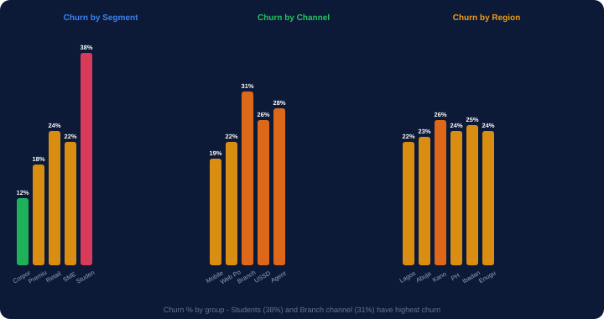
STAGE 8 - Churn Analysis: Who Churns and Why?
churn.py
# Churn rate by segment
churn_by_seg = (df.groupby('segment')['churned']
.apply(lambda x: (x=='Yes').mean()*100)
.reset_index()
.rename(columns={'churned':'churn_rate'}))
sns.barplot(data=churn_by_seg,
x='segment', y='churn_rate',
palette='Reds_r')
plt.axhline(y=24, color='black', linestyle='--',
label='Overall 24% churn')
plt.title('Churn Rate by Segment')
plt.show()
# Satisfaction distribution: churned vs retained
fig, ax = plt.subplots(figsize=(10,6))
df[df['churned']=='Yes']['satisfaction'].hist(
ax=ax,bins=20,alpha=0.6,
color='#F43F5E',label='Churned')
df[df['churned']=='No']['satisfaction'].hist(
ax=ax,bins=20,alpha=0.6,
color='#3B82F6',label='Retained')
ax.legend(); ax.set_xlabel('Satisfaction')
plt.title('Satisfaction: Churned vs Retained')
plt.show()
Code
What It Does
groupby('segment')['churned'].apply(lambda)
Groups by segment, then for each group applies a function that counts 'Yes' values as a percentage.
(x=='Yes').mean()*100
For each group: x=='Yes' creates True/False. .mean() computes the fraction of True. *100 converts to percentage.
plt.axhline(y=24)
Draws a horizontal reference line at the overall churn rate (24%). Bars above this line are worse than average.
Two histograms on same axes
Overlaying two histograms with alpha=0.6 (transparency) shows the distribution overlap. Clear separation = the variable is a good churn predictor.
# Key: Student 38%, Branch 31%, Corporate 12% - action required for student segment
Key action: Students 38%
Student segment has 38% churn vs 24% overall. Requires targeted retention programmes: financial literacy content, student account benefits, reduced fees.
Notes:
Target analysis. This stage is the payoff of all the previous EDA work. The churn by segment chart immediately shows where the business problem is concentrated: Students (38%) and Branch channel (31%). The satisfaction overlap histogram shows churned customers cluster at scores 1-5 while retained customers cluster at 6-10. This is the most actionable slide in the entire deck.

Slide 27
EDA SUMMARY - Key Findings from eda_fintech_dataset.csv
1. Amount is highly right-skewed
2. Student segment has 38% churn
Mean (NGN 1.04M) &gt;&gt; Median (NGN 188K). The 734 Corporate customers drive most of the revenue despite being 15% of customers. Always segment before computing averages.
Almost double the overall rate (24%). Students transact small amounts but are the future customer base. Retention investment here has long-term value.
3. Satisfaction is top churn predictor
4. Product stickiness effect confirmed
Correlation: -0.35. Customers with scores 1-4 churn at over 50%. Scores 8-10 churn at under 10%. Improving NPS by 1 point reduces churn materially.
num_products vs churn correlation: -0.28. Single-product customers churn at 34%. Five-product customers churn at under 8%. Cross-selling is retention.
5. December is peak month
6. amount-fees correlation 0.95
471 transactions in December - 23% above the monthly average. Revenue also peaks. Ensure system capacity and promotional offers are ready by November.
fees_paid is mathematically derived from amount. This is not a useful correlation for prediction. Always remove derived columns before modelling to prevent data leakage.
Notes:
EDA Summary. These 6 insights drive all subsequent decisions: model features (satisfaction, num_products), business strategy (Student retention programme, cross-sell campaign), engineering decisions (December capacity), and data science decisions (remove fees_paid before modelling - it leaks information about amount). EDA is done when you have insights that drive decisions.

Slide 28
EDA QUICK REFERENCE - All Techniques and Commands
Understand
Univariate Numeric
Univariate Categorical
Log Transform
df.shape df.info() df.describe()
df.isnull().sum() df.nunique()
df.select_dtypes(include='number')
sns.histplot(df['col'], kde=True)
plt.hist(df['col'], bins=50)
df['col'].skew() df['col'].kurtosis()
df['col'].value_counts()
sns.countplot(data=df, x='col')
df['col'].value_counts(normalize=True)
np.log1p(df['col']) # skewed data
df['col_log'] = np.log1p(df['col'])
df['col'].skew() # measure skewness
Bivariate Scatter
Bivariate Box
Correlation
Pairplot
sns.scatterplot(data=df, x='a', y='b', hue='cat')
plt.scatter(df['a'], df['b'], alpha=0.4)
r = df['a'].corr(df['b'])
sns.boxplot(data=df, x='cat', y='num')
sns.violinplot(data=df, x='cat', y='num')
df.groupby('cat')['num'].describe()
df[num_cols].corr()
df[num_cols].corr(method='spearman')
sns.heatmap(corr, annot=True, cmap='coolwarm')
sns.pairplot(df, hue='target', vars=[...])
df[num_cols].corr().abs().unstack().sort_values()
Time Series
Outliers IQR
Target Analysis
Pivot Table
df.groupby('month_num')['col'].sum()
plt.plot(x, y, marker='o')
df.groupby('day_of_week')['col'].count()
Q1=df['col'].quantile(0.25)
Q3=df['col'].quantile(0.75)
IQR=Q3-Q1; upper=Q3+1.5*IQR
df.groupby('cat')['target'].apply(lambda x: (x=='Yes').mean())
df[df['target']=='Yes']['num'].hist(alpha=0.6)
pd.pivot_table(df,index='a',columns='b',
values='c',aggfunc='mean',fill_value=0)
Notes:
EDA cheat sheet. Print and distribute to students. The pattern across all EDA techniques: understand the data type -> choose the right chart -> compute the right statistic -> interpret the result -> derive an insight. Every technique in this sheet is covered in the accompanying notebook with the fintech dataset.

Slide 29
🔍
Exploratory Data Analysis
eda_fintech_dataset.csv
8 stages of EDA completed:
Stage 1: Understand
Stage 2: Univariate
Stage 3: Bivariate
Stage 4: Multivariate
Stage 5: Time Series
Stage 6: Outliers
Stage 7: Correlation
Stage 8: Target Analysis
EDA is done when data answers questions that drive decisions.
Files for this session:
eda_fintech_dataset.csv - upload to Colab (5,000 rows, 23 cols)
eda_notebook.ipynb - run cell by cell alongside these slides
Next: Feature Engineering and Machine Learning with Scikit-Learn
Kajola Gbenga Adewale
Data Analytics Expert
Notes:
Closing slide. Three files for this session. The EDA findings directly feed the next session: satisfaction and num_products are the top features to include in a churn prediction model. The log-transformed amount column is the right format for regression. The Student segment is the priority business problem to address.

